Slide 1
Australia Health Sites
Group 3

Slide 2

Introduction
Our Aim:
The creation of a dashboard that enables users to explore and visualise the types of health care amenities that are available to the Australian public.
The dataset:
The primary resource we used for this project was a csv.
Each row was fitted with a unique id and location data including an address, lat and lon coordinates, and the name of the health site.
Additionally, the dataset provided information on the types of health amenities. This includes pharmacy’s, doctors, clinics, dentists, and hospitals.
Using the location information and the type of amenity as inspiration, we were able to start thinking about the story we wanted to tell.

Slide 3
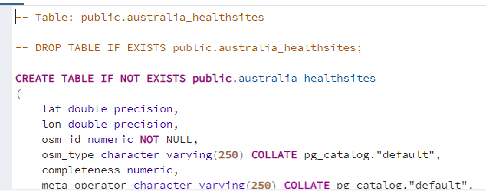
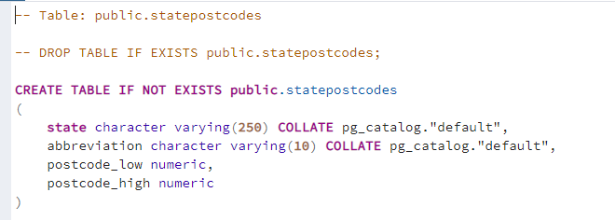
Coding Approach: Database
Database:
Upon examination of our data, it was decided that a relational database would be the most appropriate way to store and query the sought after information. We chose PostgreSQL to manage our database.
Two tables were created:
A primary table that stored healtsite information including unique id, geo-location and type of health site.
A secondary table was created to store collated postcode and state data. This information was acquired through web-scraping
Finally, the two tables were joined in the instance where here was available postcode information on the primary table. The provided tables served as a way for the flask App to access the database.

Slide 4
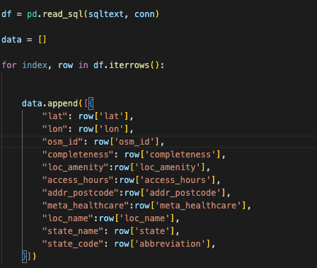
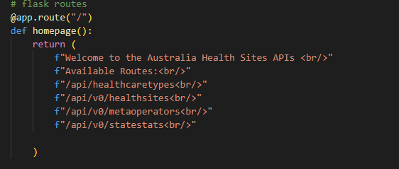
Coding Approach: Flask App
The purpose of the flask app was to connect our website to the SQL database.
We created routes that accessed the database and returned the table data as a json formatted response

Slide 5
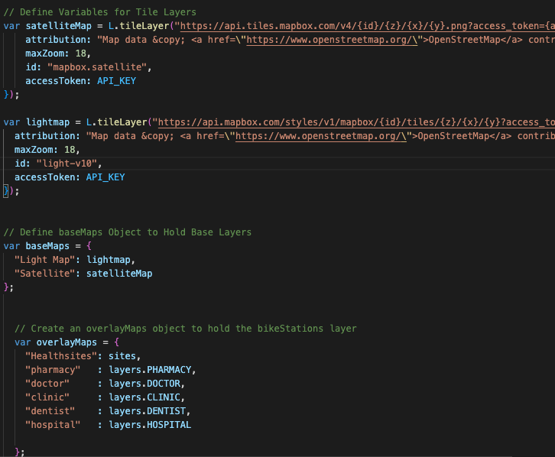
Coding Approach: Javascript/CSS
Using d3.json() we loaded the information to an app that displayed health sites on a geomap
We used mapbox to create maps on javascript
We used leaflet to visualise the health site dashboard. This enabled the user to filter the results.
CSS was used to format the graphs

Slide 6
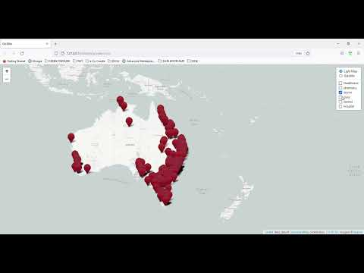
Australian Health Sites Map

Slide 7
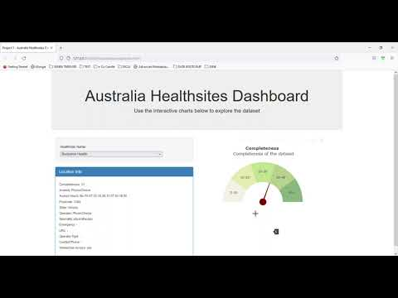
Interactive Dashboard

Slide 8
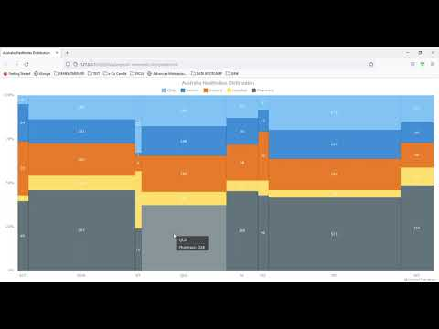
New library - Anychart :
Anychart: Interactive JavaScript charts designed to be embedded and integrated into web, desktop, and mobile apps

Slide 9
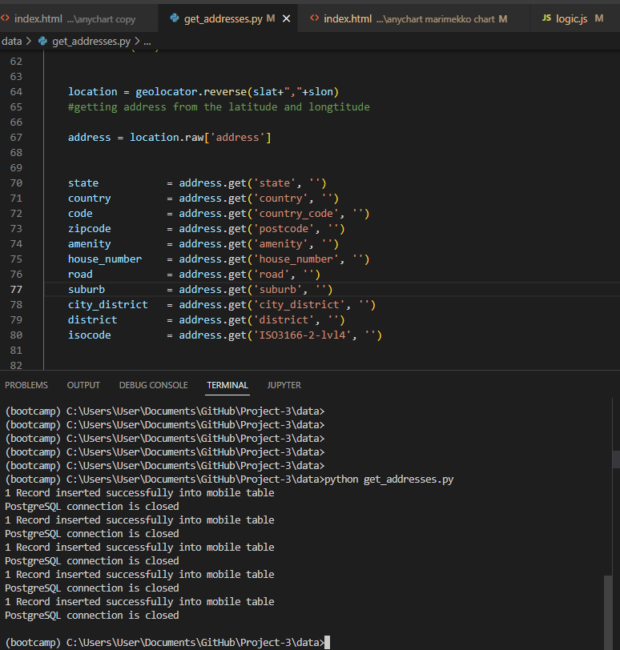
We have the lat and lot, but not the state
Geocode Module allows you to easily and quickly get information about given location.
Geocode Module returns such information as:
country,
state,
country short form,
city,
route/street,
street number,
postal code,
formatted address

